Slide 1

MATLAB Control of Keysight Scopes
Diego Sena
Professor Eric Bogatin
Summer 2023

Slide 2
Agenda
Goals and Objectives
So What? Why is this Important?
Test Plan
Applications
Conclusion
Future Work
Takeaways

Slide 3
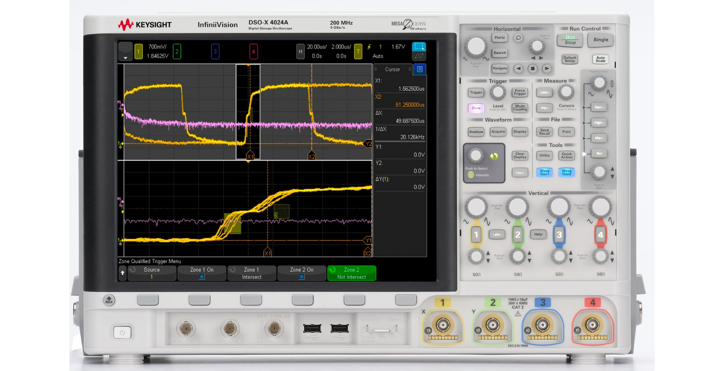

Goals and Objectives
Create a software defined instrument (SDI) with the KEYSIGHT Scope with MATLAB
Analyze the bandwidth of the scope and scope cables

Slide 4
So What? Why is this important
To characterize the maximum frequency sampleable by the scope and scope cables
To confirm the manufacturer’s specifications
Tells engineers what signals they can and can’t measure with each piece of equipment (for this equipment AM to FM frequencies)

Slide 5
System Diagram
Function Generator
Input
Oscilloscope
Control
MATLAB
Output
Transfer Function
Data

Slide 6
Test Plan
Test Signal:
1Vpp 10 MHz Sin Wave
Compare:
An Ideal 10 MHz Sin Wave
Measured a 10 MHz Sin Wave
Expected Output:
The ideal and measured data and calculated FFT should line up as they are the same signal.

Slide 7
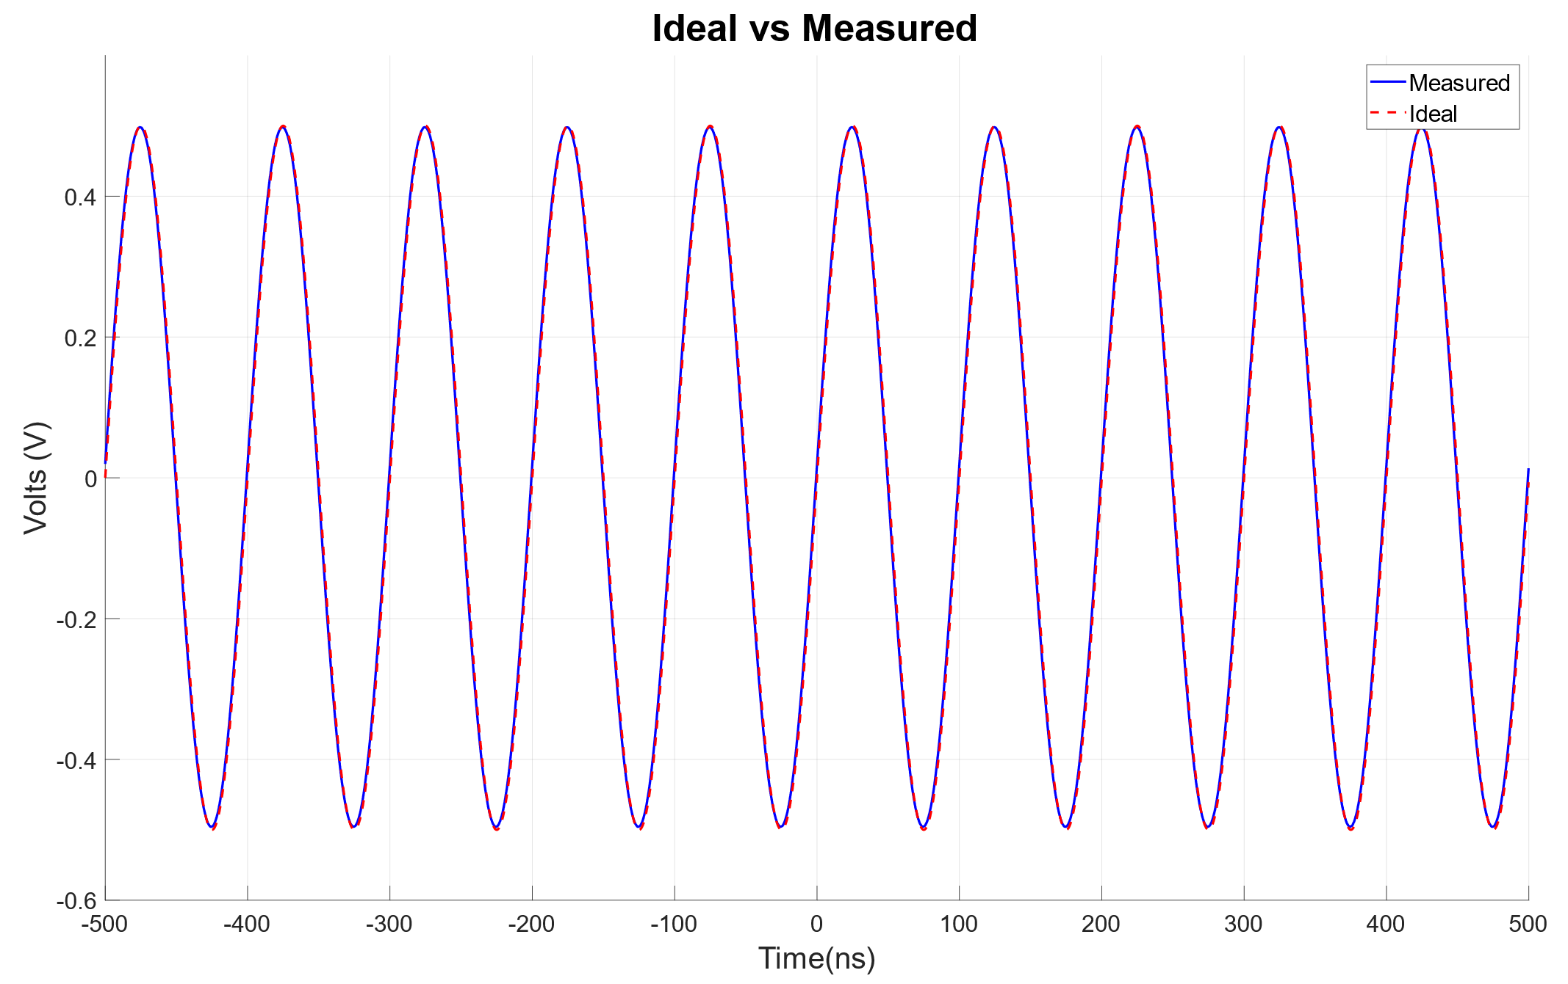
Consistency Test 1: 10 MHz Sin Wave
Function Generator
Input:
10MHz
Sin Wave
Oscilloscope

Slide 8
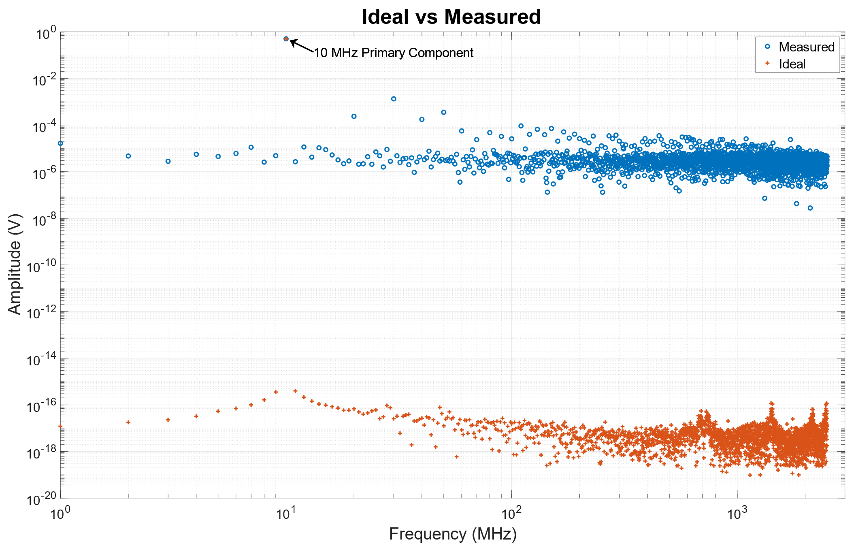
Consistency Test 1: 10 MHz Sin Wave FFT
Oscilloscope
Measurement Noise Floor
Data
Control
MATLAB
Computer Noise Floor

Slide 9
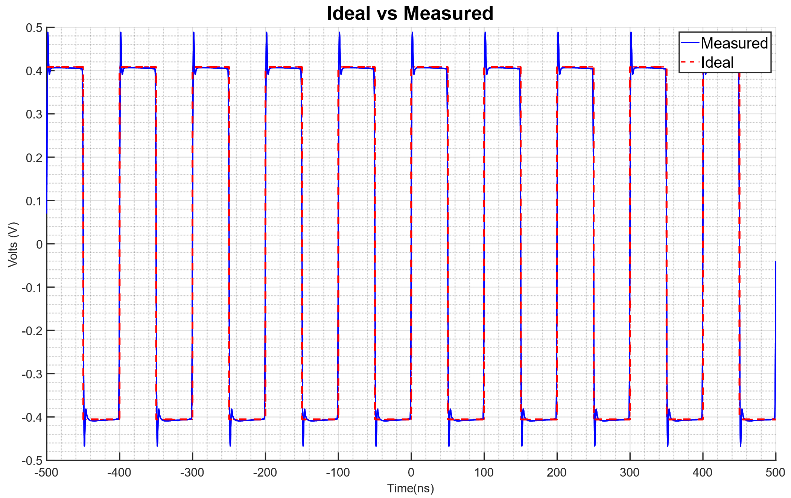
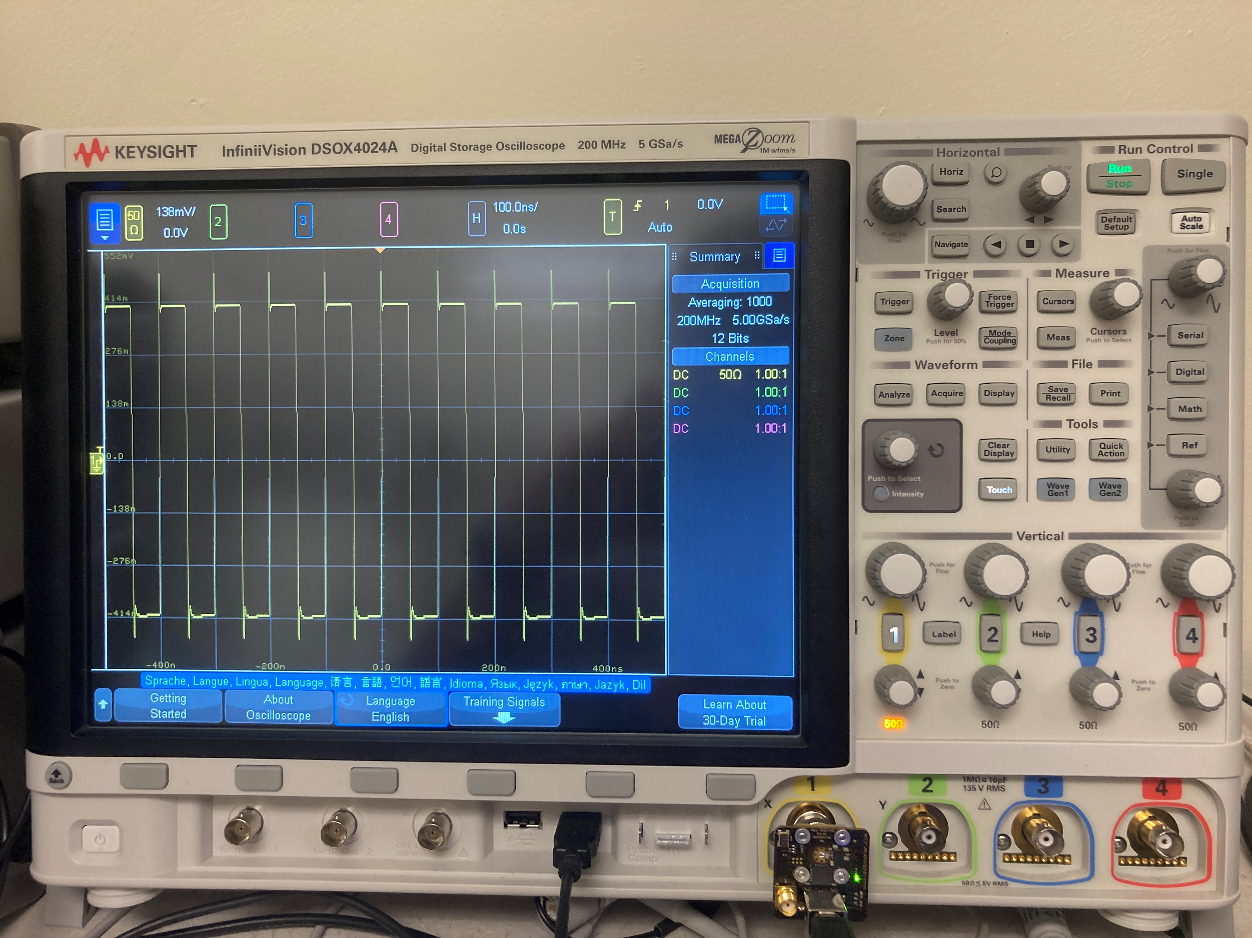
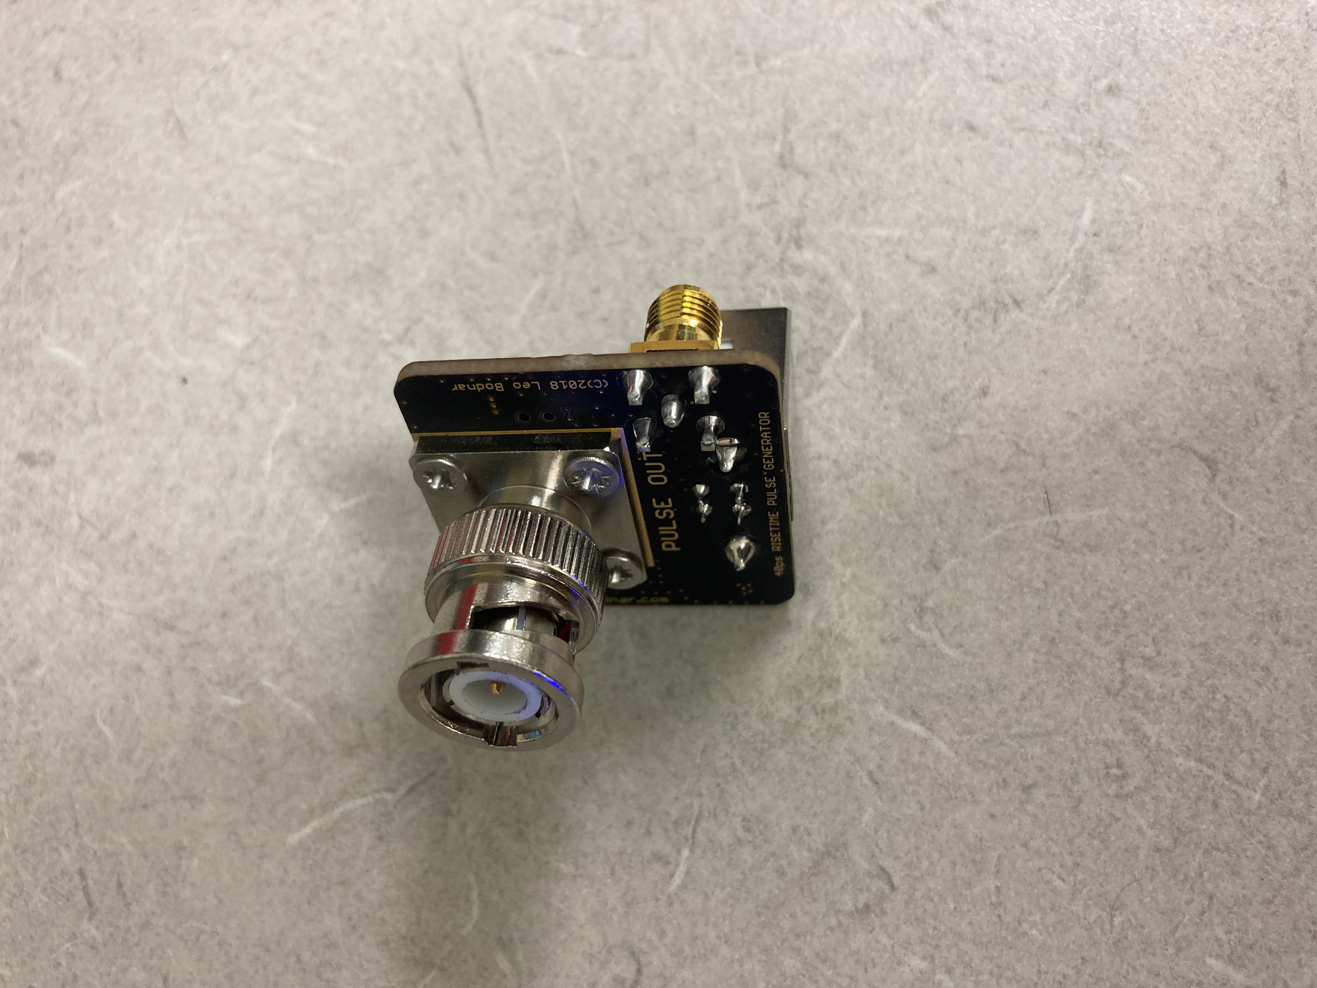
Finding Bandwidth of Oscilloscope

Slide 10
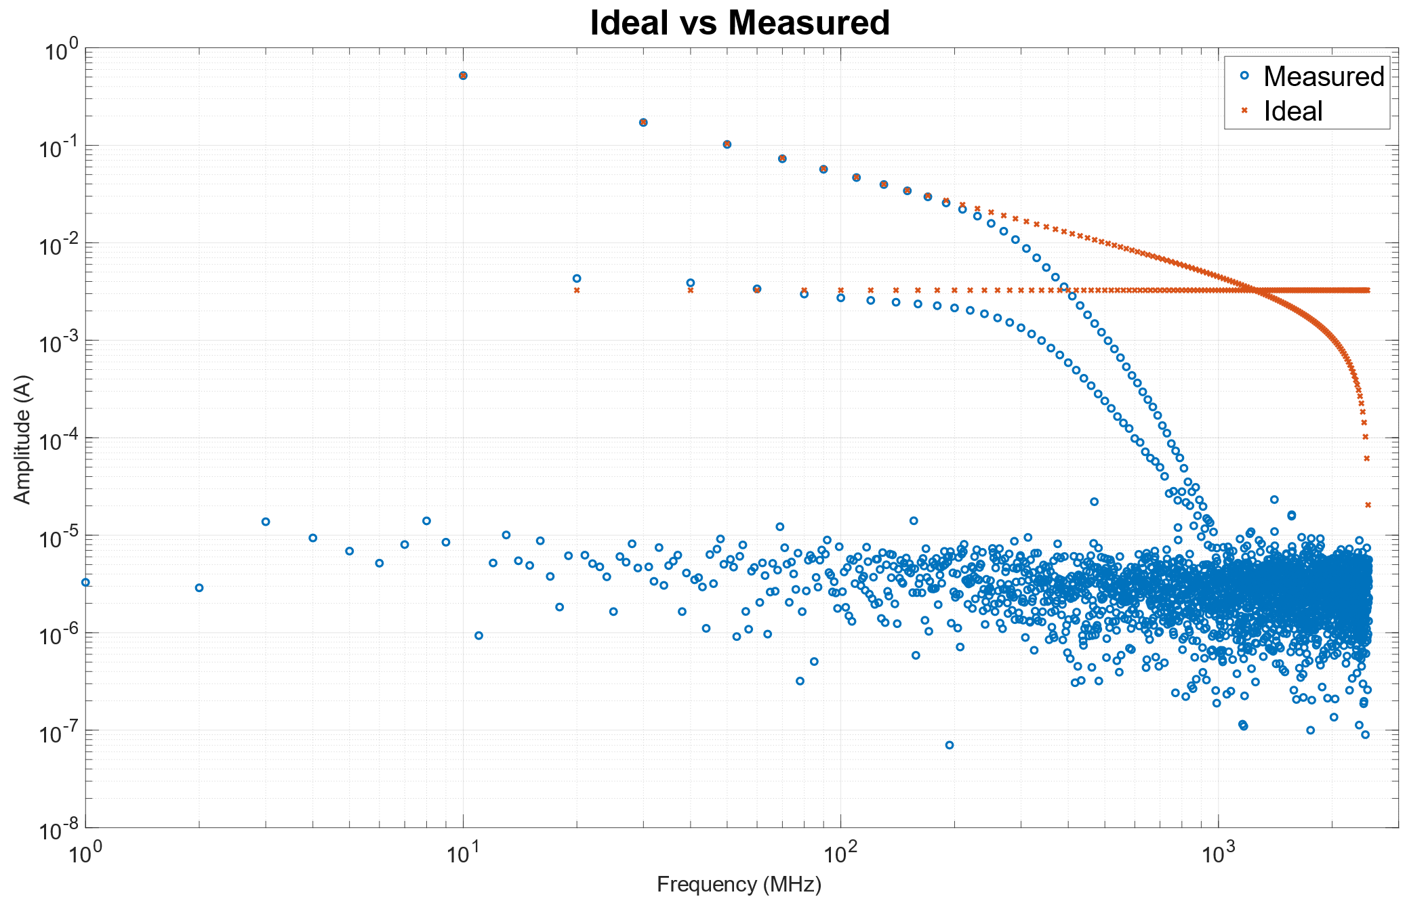
LogLog FFT of Square Wave
10 MHz Primary Component
Oscilloscope
Odd Harmonics
Even Harmonics
Data
Control
MATLAB
Noise Floor

Slide 11
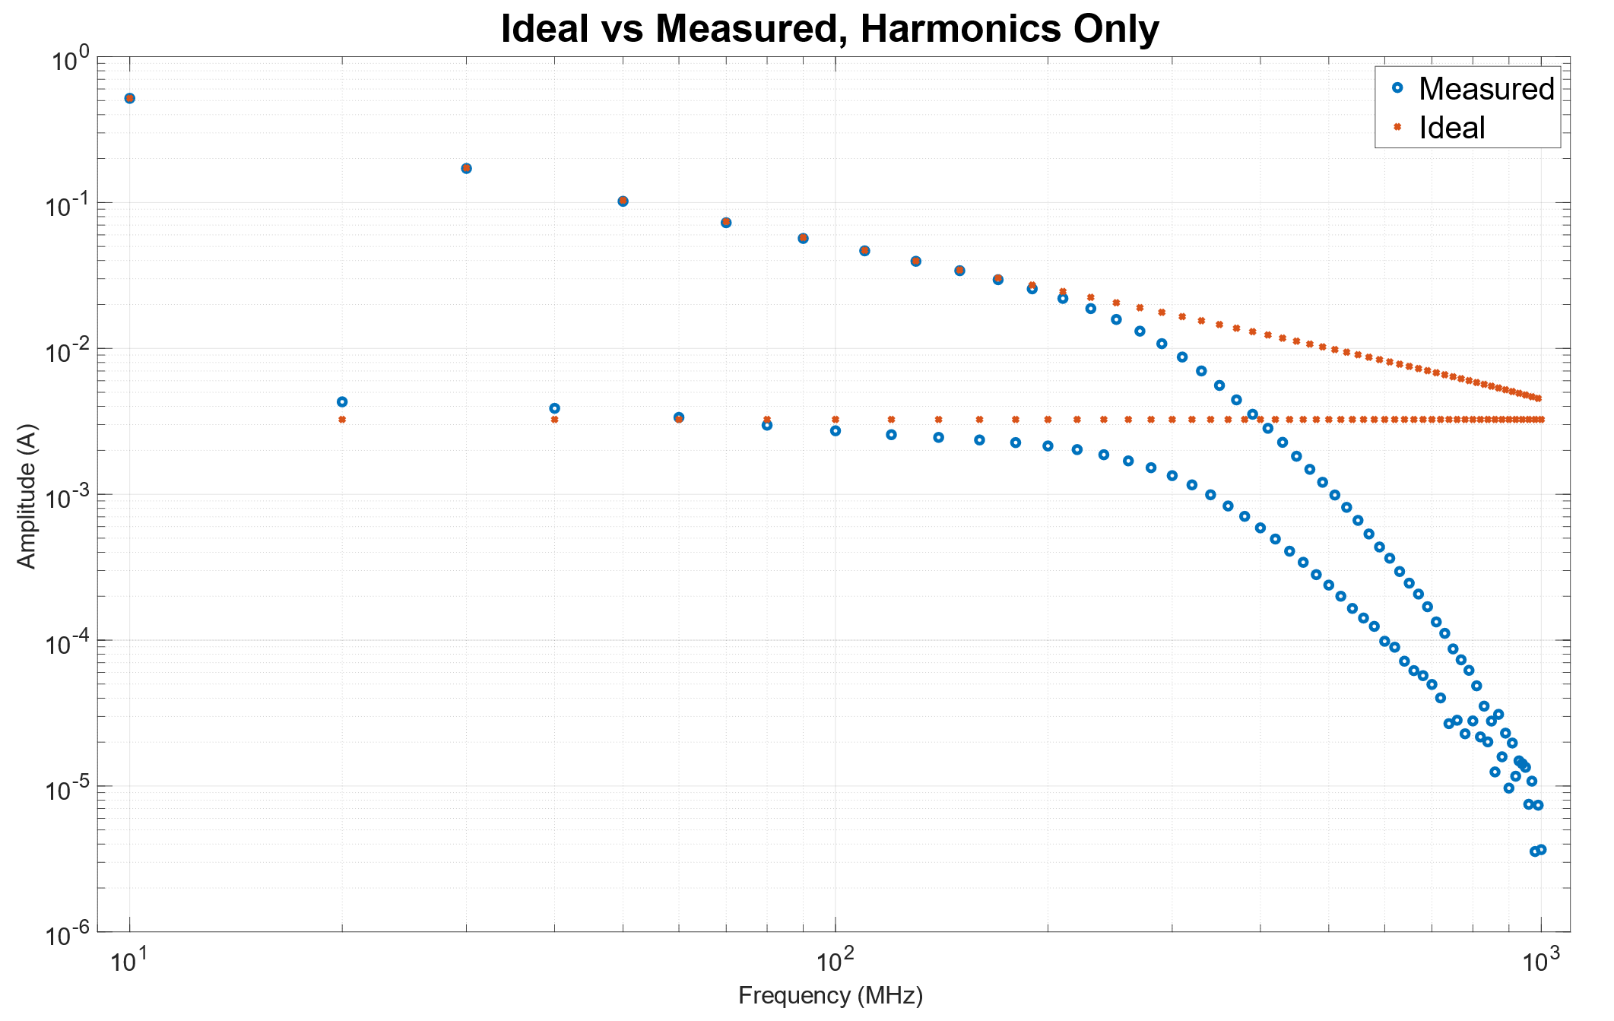
LogLog FFT Harmonics Only
Duty Cycle is 50.167%
Odd Harmonics
Even Harmonics

Slide 12
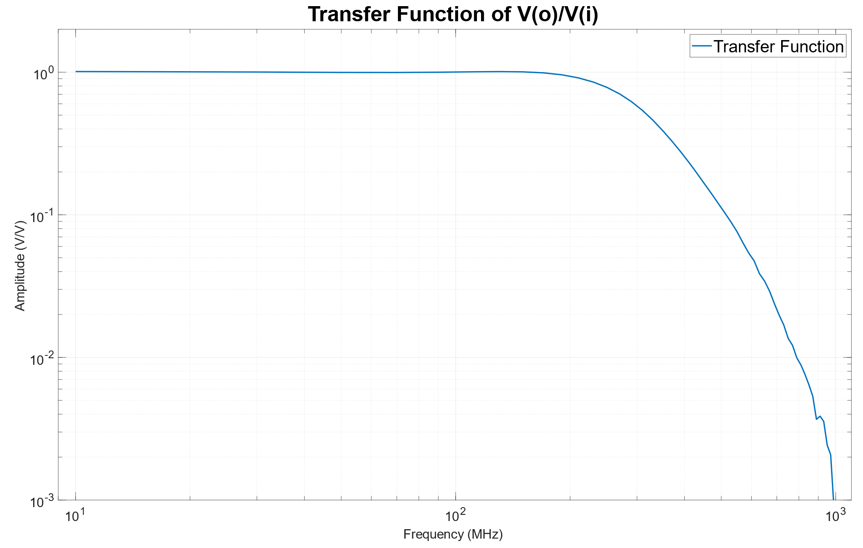
Transfer Function of the Scope
MATLAB
3dB Down Point
Corner Frequency at 270 MHz
Output
Transfer Function

Slide 13
Conclusion
Confirmed the scopes 200MHz filter which is closer to 270MHz filter to allow for user error going up to the 200MHz filter
With the high-speed square wave creates harmonics that allow for characterizing oscilloscopes and scope probes

Slide 14
Future Work
Check different scope probes bandwidths
Check different oscilloscopes bandwidths

Slide 15
Lessons Learned
The IVI documentation was written with specifications and requires reverse engineering
The manufacturer’s specifications are not actually what the specifications are, and they design for leeway.

Slide 16
Acknowledgement
Thank you to Professors Bogatin and Piket-May
Thank you to CU-SPUR program for the opportunity
Thank you to EEF for funding my research
Thank you to Colorado Mesa University and University of Colorado Boulder

Slide 17
Questions

Slide 18
Literature Search, Background
Understand DFT and FFTs
IVI library
MATLAB
Square Wave DFT

